Slide 1
JSP Exception

Slide 2
JSP Implicit object
In this module we will see below topics
JSP Exception

Slide 3
JSP Exception
Using Exception Object
The exception object is an instance of a subclass of Throwable (e.g., java.lang. NullPointerException) and is only available in error pages. Following table lists out the important methods available in the Throwable class.
JSP gives you an option to specify Error Page for each JSP. Whenever the page throws an exception, the JSP container automatically invokes the error page.
Following is an example to specifiy an error page for a main.jsp. To set up an error page, use the <%@ page errorPage = "xxx" %> directive.
To understand how exception is handled by jsp page we will see one example.

Slide 4
JSP Exception Example Duration:15 min
main.jsp
<%@ page errorPage = "ShowError.jsp" %>
<html>
<head>
<title>Error Handling Example</title>
</head>
<body>
<%
// Throw an exception to invoke the error page
int x = 1;
if (x == 1) {
throw new RuntimeException("Error condition!!!");
}
%>
</body>
</html>
We will now write one Error Handling JSP ShowError.jsp, which is given below.
Notice that the error-handling page includes the directive <%@ page isErrorPage = "true" %>. This directive causes the JSP compiler to generate the exception instance variable.
ShowError.jsp
<%@ page isErrorPage = "true" %>
<html>
<head>
<title>Show Error Page</title>
</head>
<body>
<h1>Oops...</h1>
<p>Sorry, an error occurred.</p>
<p>Here is the exception stack trace: </p>
<pre><% exception.printStackTrace(response.getWriter()); %></pre>
</body>
</html>
Here is the output
java.lang.RuntimeException: Error condition!!! at org.apache.jsp.main_jsp._jspService(main_jsp.java:120) at
…….
Opps...
Sorry, an error occurred.
Here is the exception stack trace

Slide 5
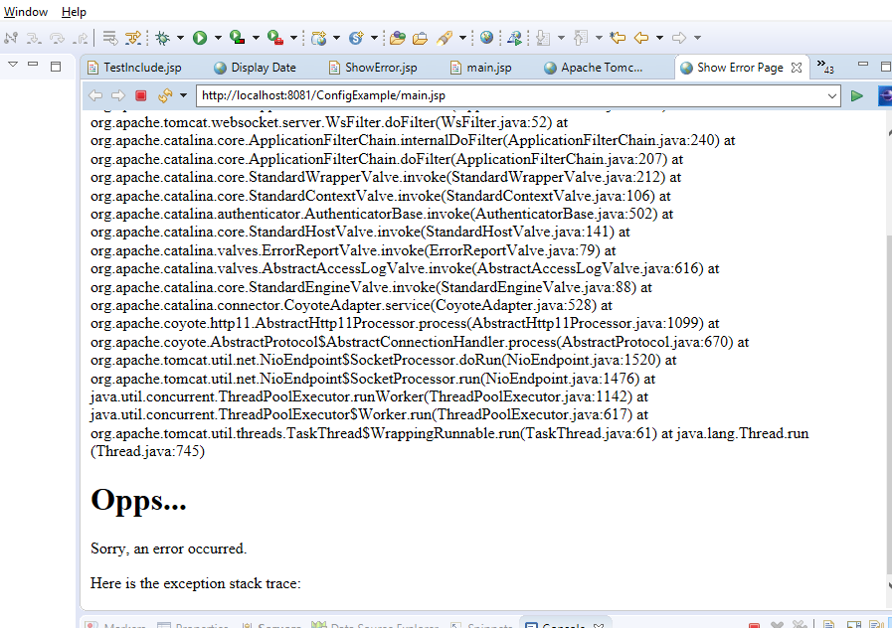
JSP Exception

Slide 6
JSP Exception Example Duration:10 min
Using Try...Catch Block
If you want to handle errors within the same page and want to take some action instead of firing an error page, you can make use of the try....catchblock.
Following is a simple example which shows how to use the try...catch block. Let us put the following code in main.jsp −
<html>
<head>
<title>Try...Catch Example</title>
</head>
<body>
<%
try {
int i = 1;
i = i / 0;
out.println("The answer is " + i);
}
catch (Exception e) {
out.println("An exception occurred: " + e.getMessage());
}
%>
</body>
</html>
After Executing the main.jsp
We get following output
An exception occurred: / by zero

Slide 7

Thank You

